Slide 1

WIPRO– 25VID0810_SDET-Batch 1
Capstone Project Presentation –13th and 14th June
Project Title Here –
1.BooksWagon_Automation
2. BooksWagon_API_Testing_Rest_Assured
Presented by – Satyam Singh
www.rpsconsulting.in

Slide 2

Table of contents
Project Overview
Tools and Technology
Project Design
BDD Cucumber with Page Object Mode
Rest Assured Api
GitHub
Jenkins
Conclusion
2025 - RPS Consulting all rights reserved

Slide 3
Project Overview
BookWagon_Automation(BDD Cucumber)
This project demonstrates the automation of an end-to-end web application workflow using a Behavior-Driven Development (BDD) framework. The application under test is a mock online bookstore, where user journeys such as login, book search, cart operations, and checkout are tested. Test scenarios are defined in plain English using Gherkin syntax, which promotes better understanding and collaboration between business stakeholders, QA engineers, and developers.
BooksWagon_APITesting(Rest Assured)
This project focusses on validating a publicly available Restful API (https://jsonplaceholder.typicode.com) using Rest Assured integrated with Cucumber for BDD-style test writing. The project covers full CRUD operations — GET, POST, PUT, and DELETE — on the /users endpoint. It verifies API status codes, response times, and JSON body contents, ensuring functional correctness and performance reliability.
3
2025 - RPS Consulting all rights reserved

Slide 4
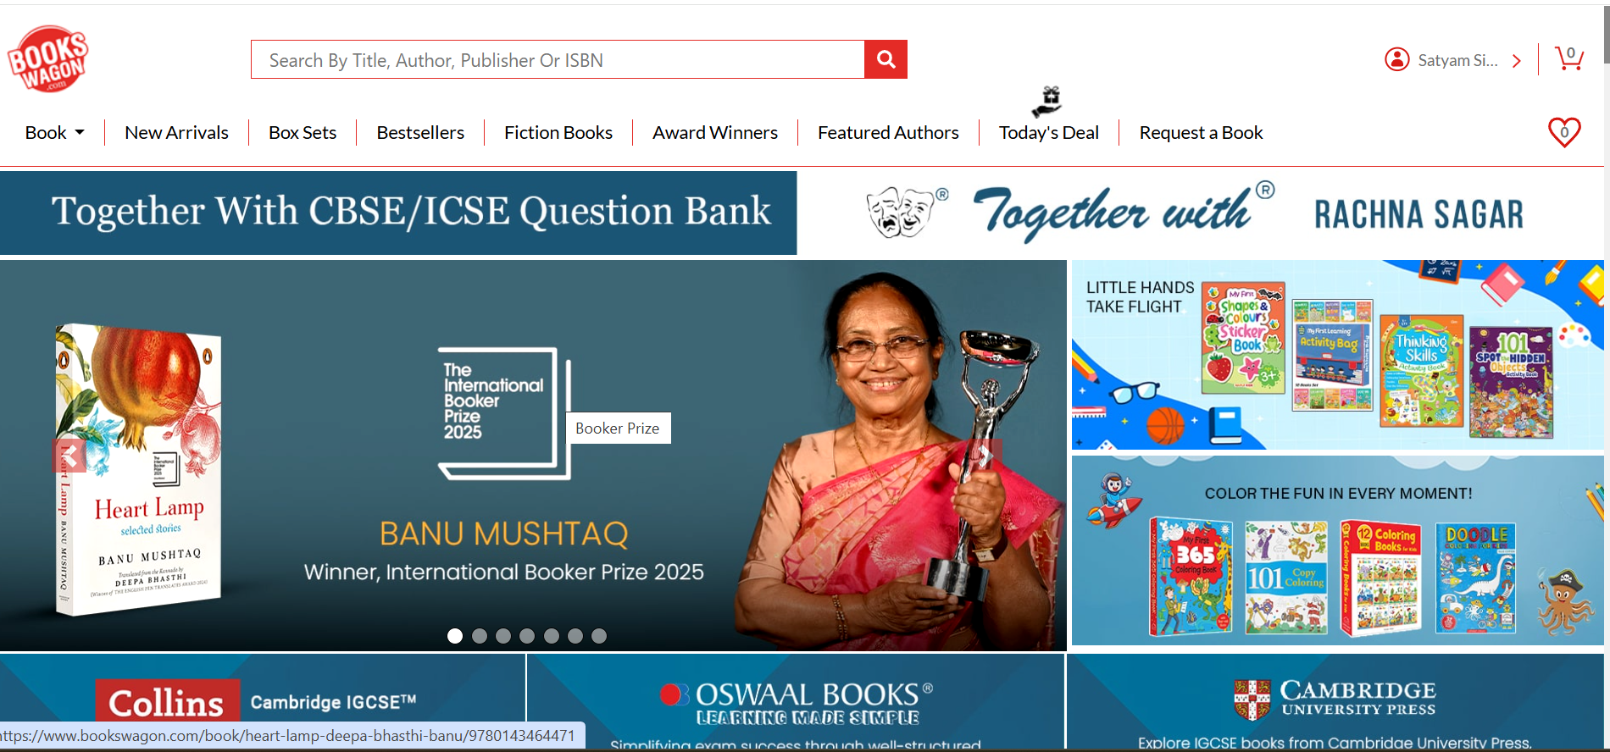
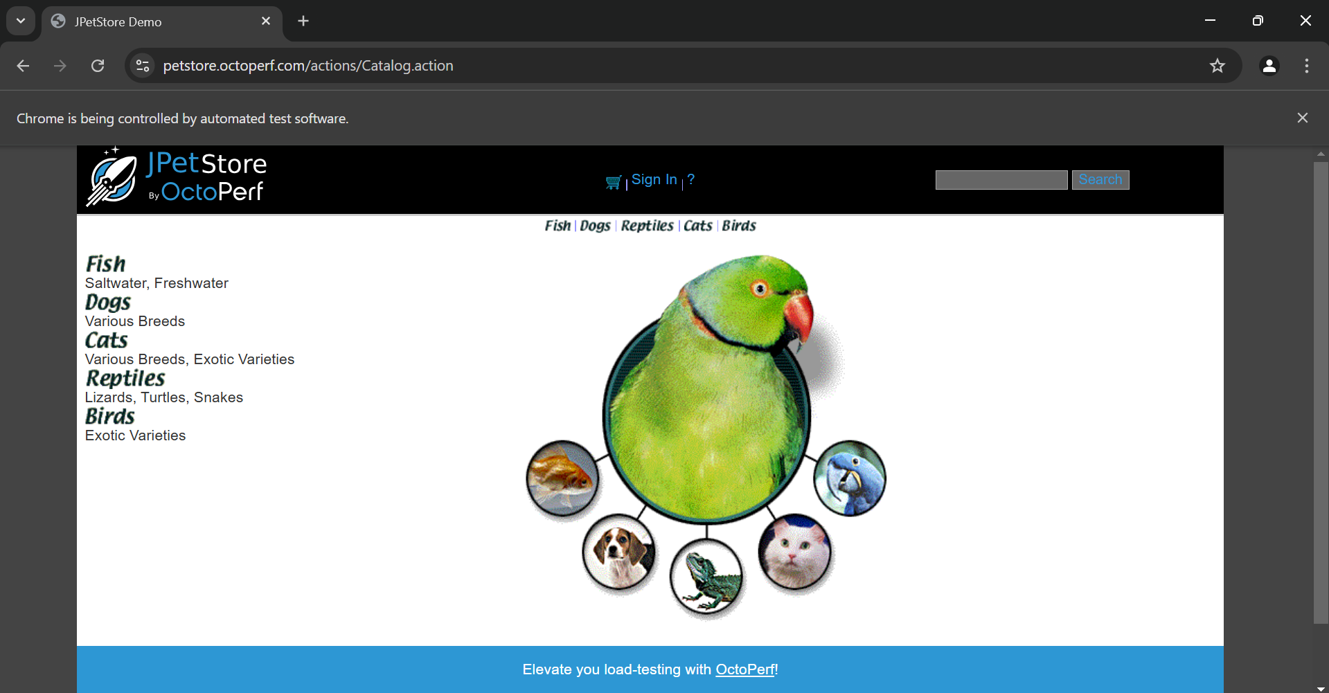
Application Website
2025 - RPS Consulting all rights reserved

Slide 5

Tools and Technologies
Eclipse IDE
Java
Maven
Selenium WebDriver
Junit Test
BDD Cucumber
Page Object Model
Extent Report
GitHub
Jenkins
Rest Assured Api
2025 - RPS Consulting all rights reserved

Slide 6
Project Design
Behavior-Driven Development approach (BDD)
Page Object Model (POM)
Rest Assured
Data-Driven approach
GitHub
Jenkin
2025 - RPS Consulting all rights reserved

Slide 7
BDD Cucumber with Page Object Mode
What is BDD (Behavior Driven Development)?
A collaborative approach where testers, developers, and business analysts define test cases in plain English.
Focuses on "What the system should do".
Written using Gherkin syntax (Given-When-Then format)
What is Cucumber?
A BDD testing tool used to write automated acceptance tests.
Uses Gherkin language to write feature files (.feature)
Integrates with Java, Selenium, and REST Assured for test execution.
What is Page Object Model (POM)?
A design pattern to create Object Repositories for web elements.
Improves code readability, reusability, and maintainability.
Each page in the application has a corresponding Java class.
7
2025 - RPS Consulting all rights reserved

Slide 8
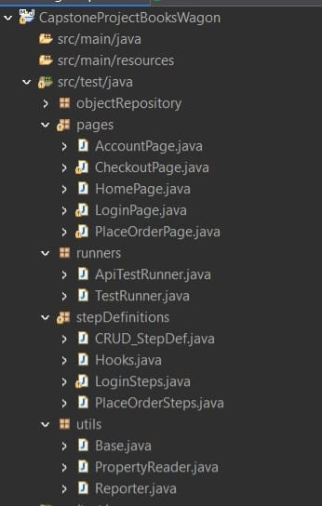
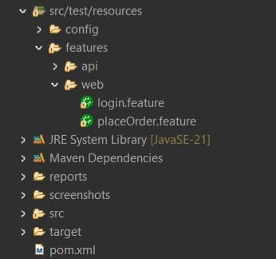
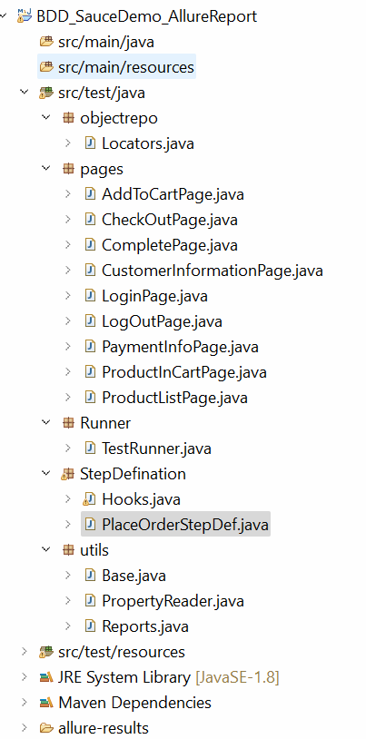
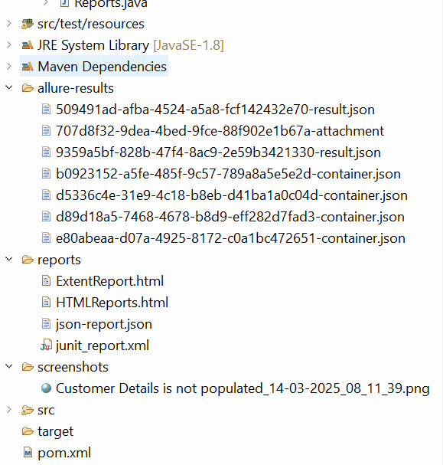
Project Structure

Slide 9
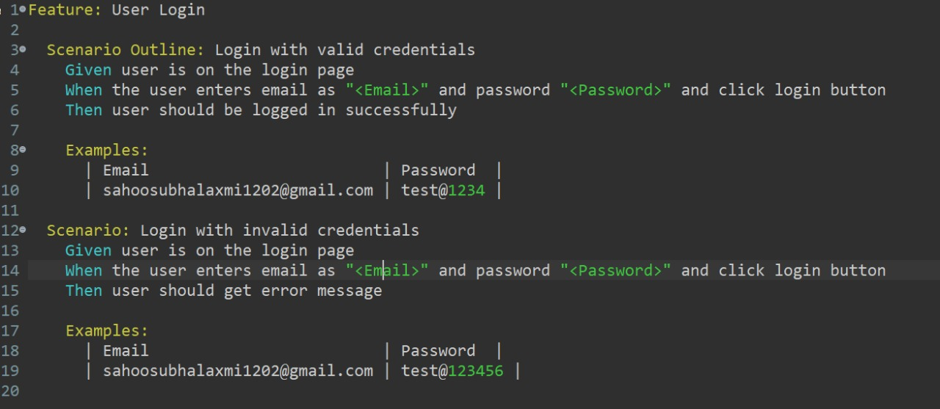
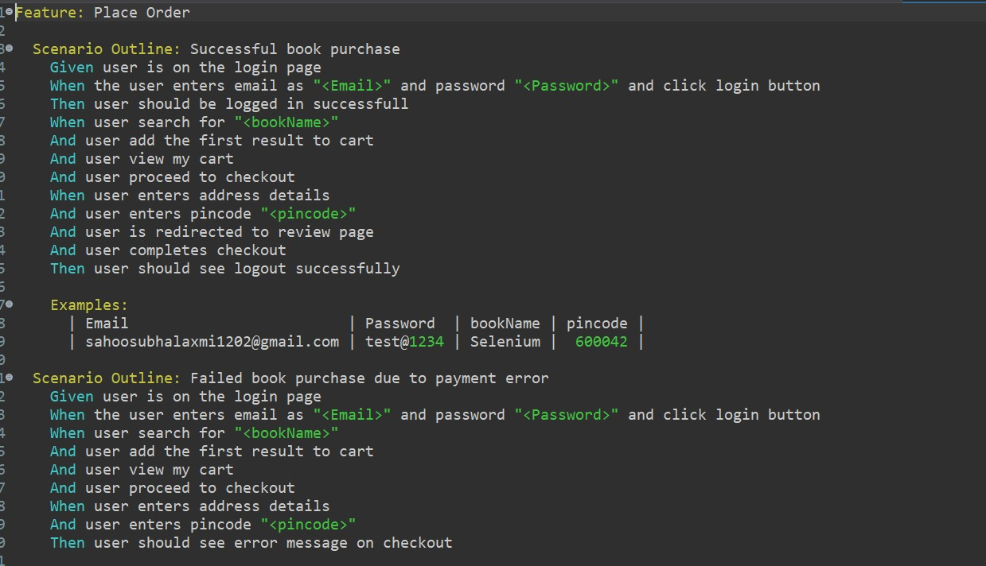
Screenshot of Feature File
2025 - RPS Consulting all rights reserved

Slide 10
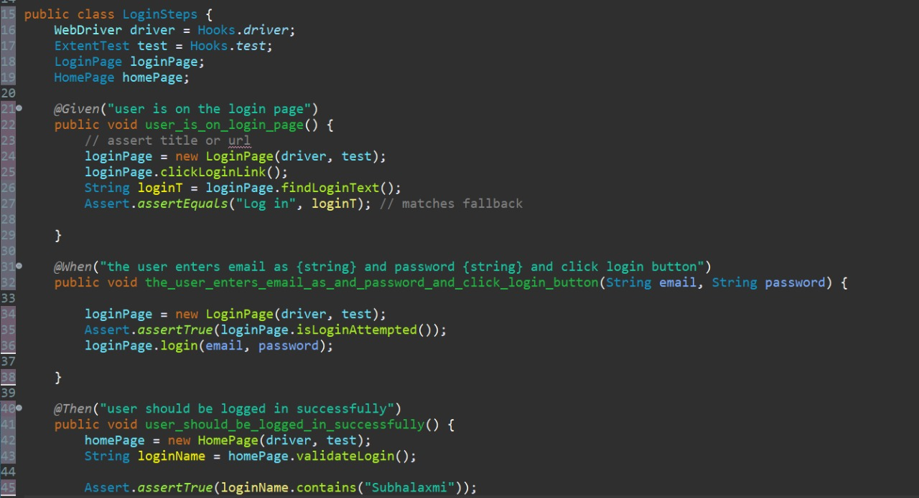
Screenshot of Step Definition File
2025 - RPS Consulting all rights reserved

Slide 11
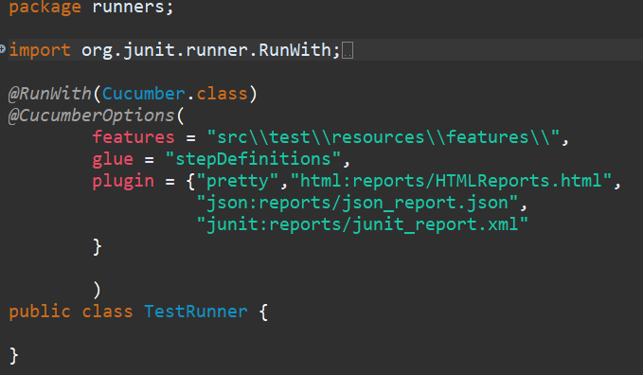
Screenshot of Test Runner File
2025 - RPS Consulting all rights reserved

Slide 12
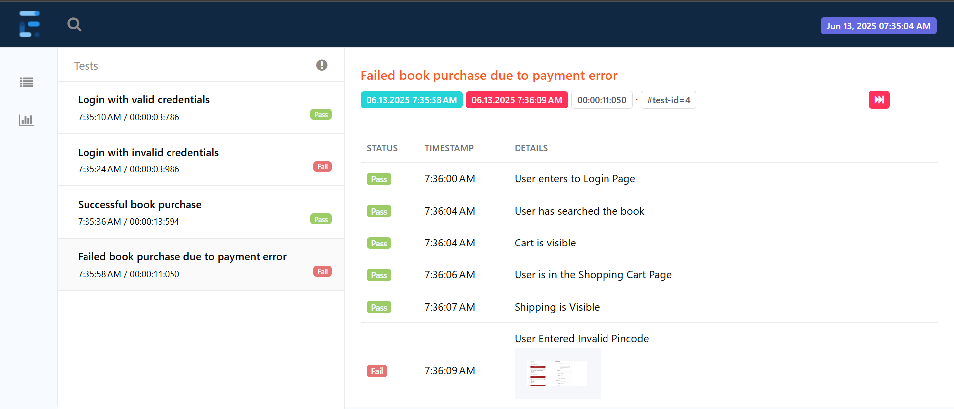
Extent Report
12
2025 - RPS Consulting all rights reserved

Slide 13
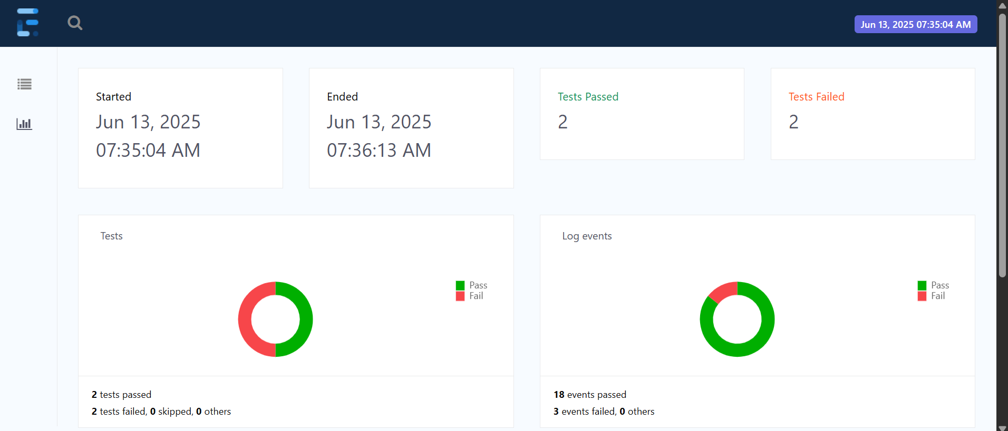
Extent Report
13
2025 - RPS Consulting all rights reserved

Slide 14
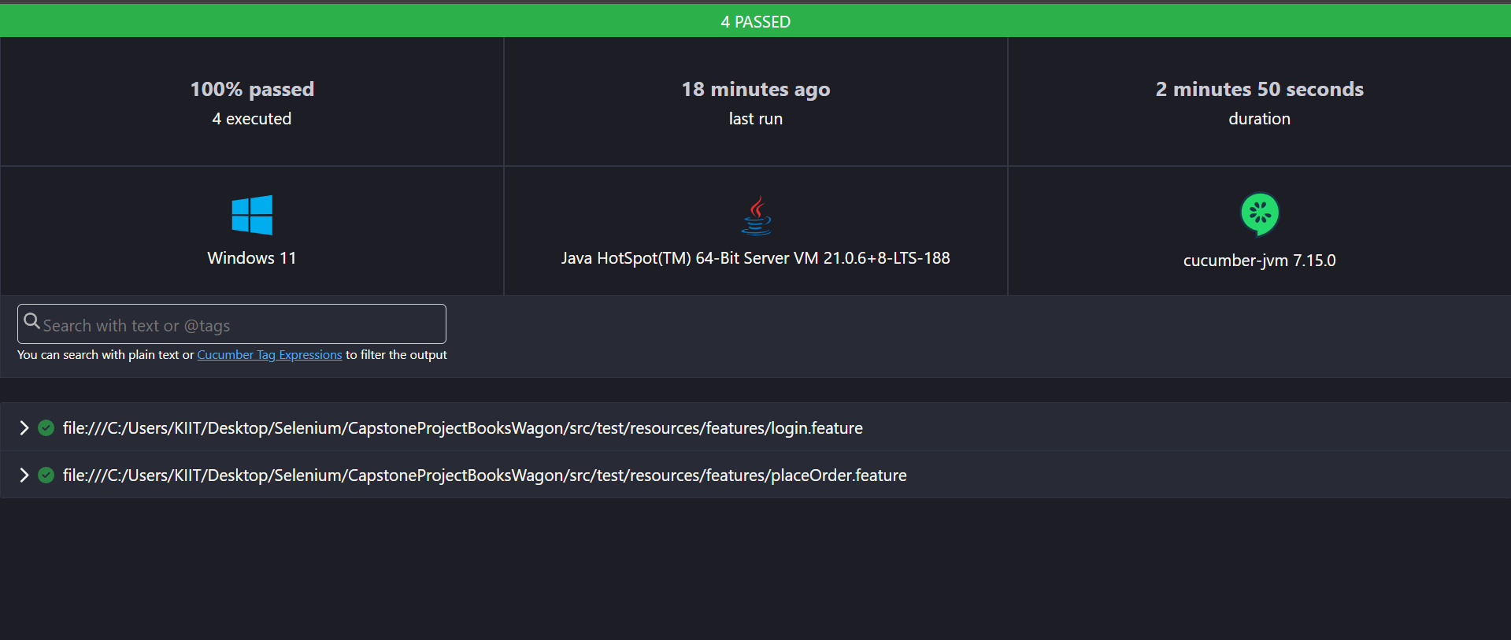
Cucumber Report of BDD Cucumber
14
2025 - RPS Consulting all rights reserved

Slide 15
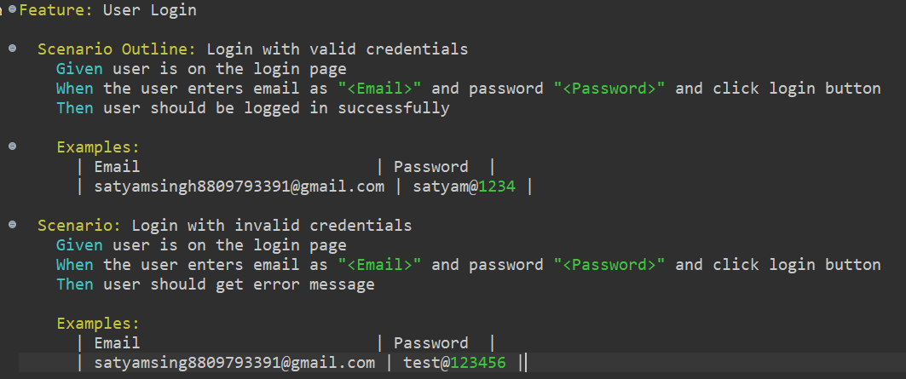
Cucumber Report of BDD Cucumber
15
2025 - RPS Consulting all rights reserved

Slide 16
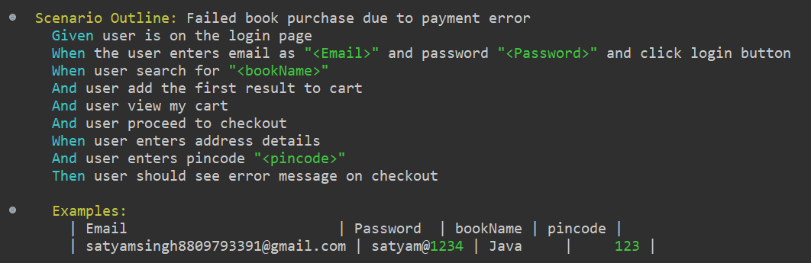
Cucumber Report of BDD Cucumber
16
2025 - RPS Consulting all rights reserved

Slide 17
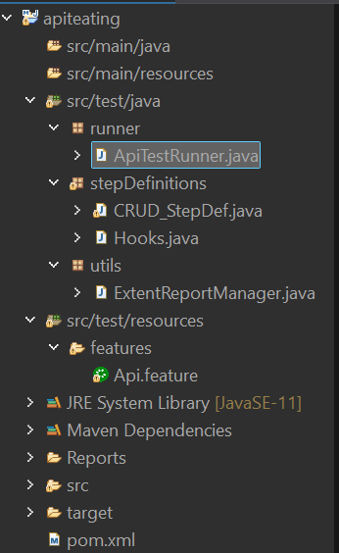
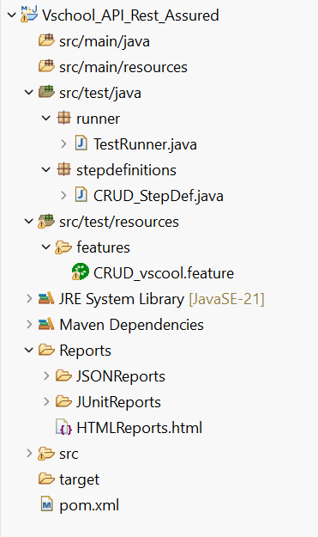
Project Structure of BooksWagon_APITesting

Slide 18
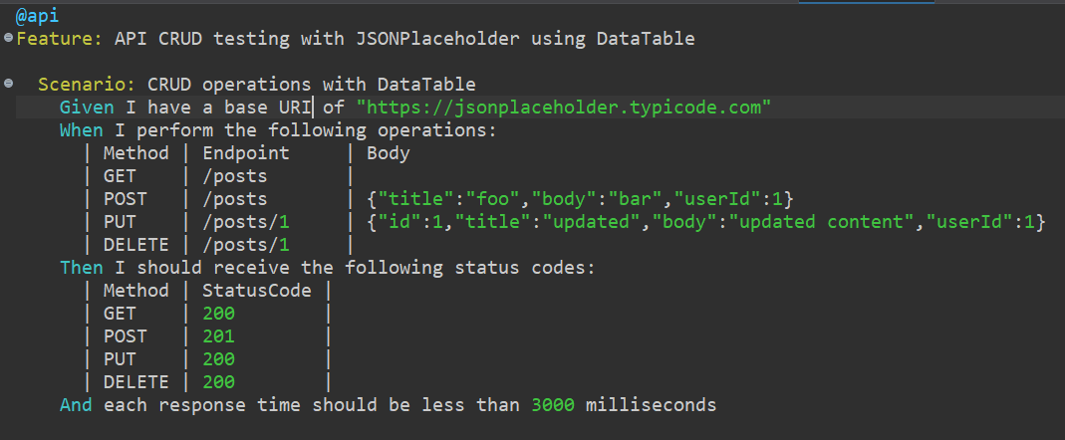
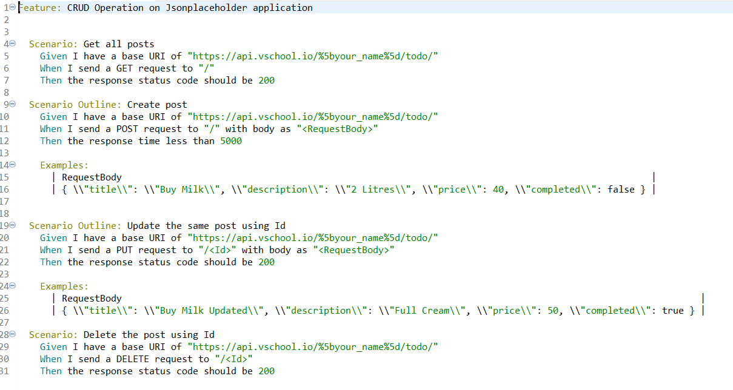
Screenshot of feature file
18
2025 - RPS Consulting all rights reserved

Slide 19
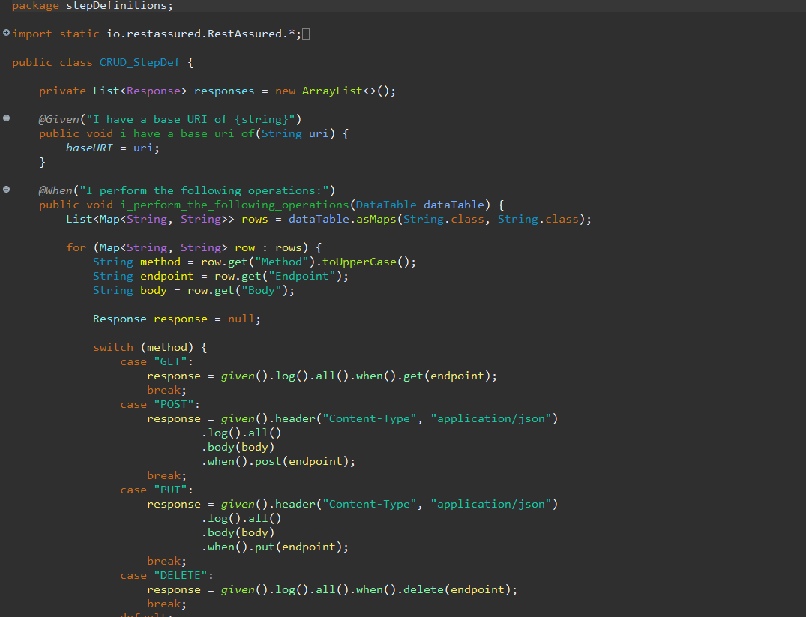
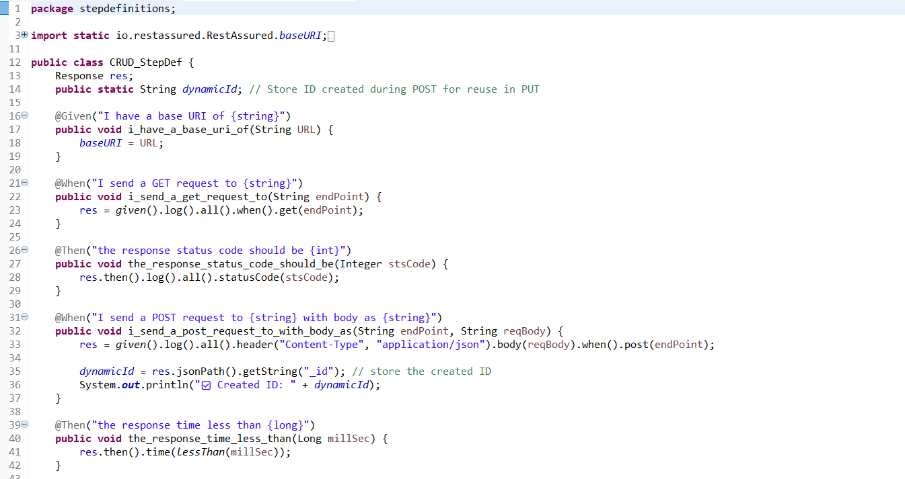
Screenshot of step definition
19
2025 - RPS Consulting all rights reserved

Slide 20
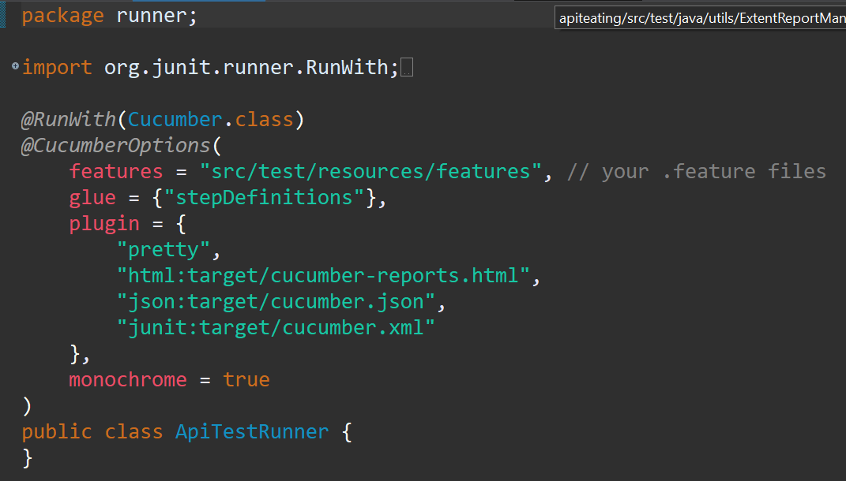
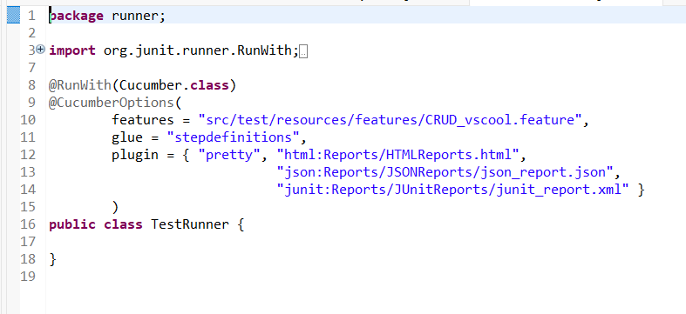
Screenshot of Test Runner File
20
2025 - RPS Consulting all rights reserved

Slide 21
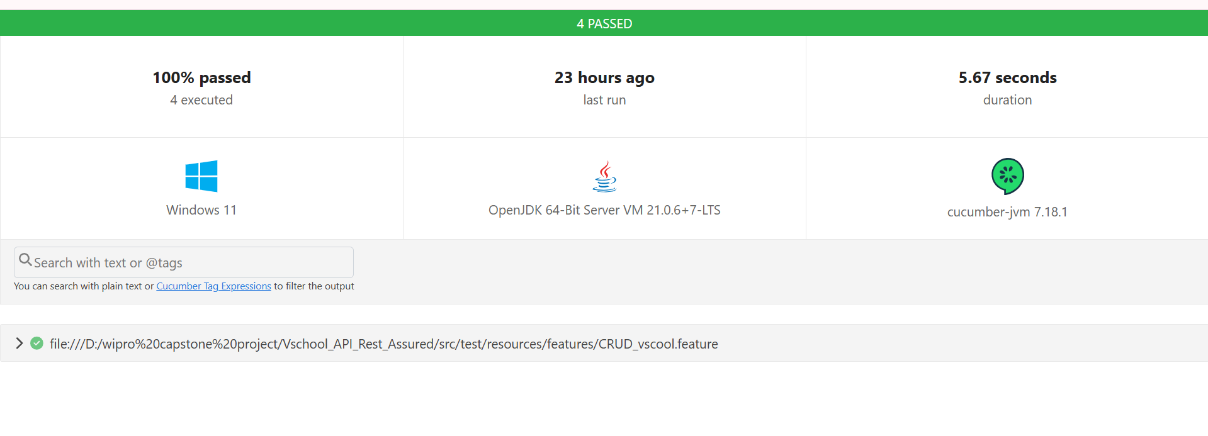
Screenshot of Cucumber Report
21
2025 - RPS Consulting all rights reserved

Slide 22
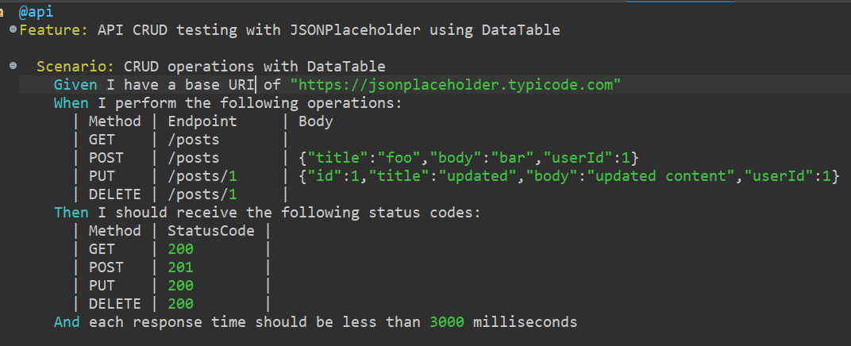
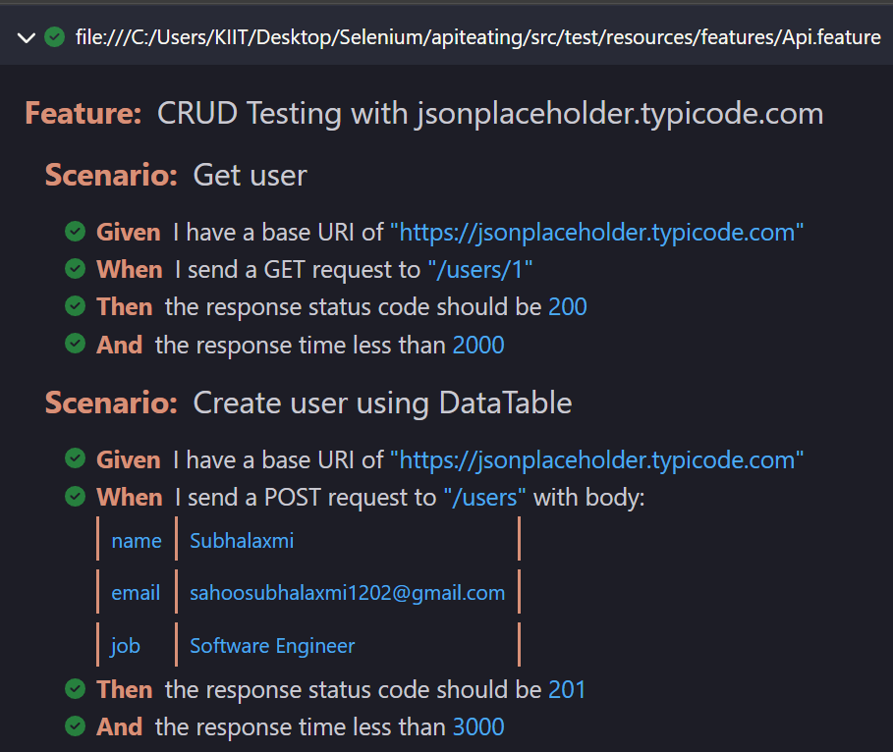
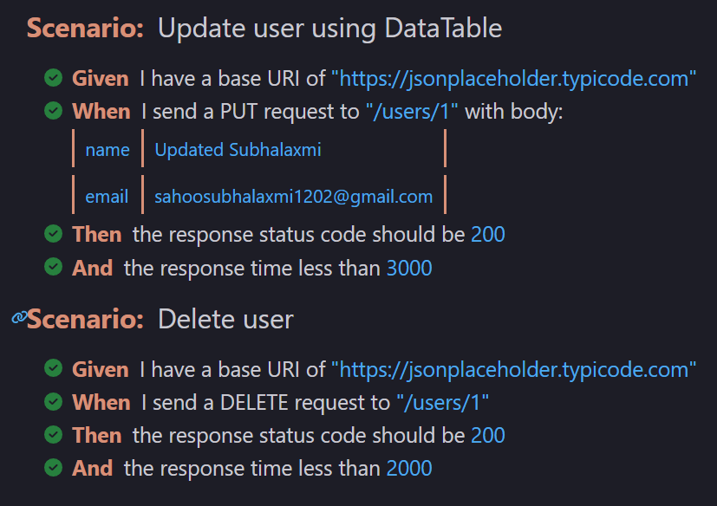
Cucumber Report
22
2025 - RPS Consulting all rights reserved

Slide 23
GitHub Screenshot

Slide 24
Jenkins Screenshot
2025 - RPS Consulting all rights reserved

Slide 25
Jenkins Results Screenshot
2025 - RPS Consulting all rights reserved

Slide 26
Conclusion
BookWagon_Automation(BDD Cucumber)
The BooksWagon_BDD project effectively demonstrates the use of Behavior-Driven Development (BDD) using Cucumber with Selenium for automating end-to-end test scenarios on the BooksWagon e-commerce platform. By writing clear, human-readable Gherkin scripts and mapping them to robust step definitions, the project ensures seamless collaboration between technical and non-technical stakeholders. It validates critical workflows like user login, book search, cart management, and order placement. This approach not only improves test maintainability and readability but also enhances the quality and reliability of the application under test.
BooksWagon_APITesting(Rest Assured)
The BookWagon_ApiTesting project demonstrates REST API automation using the REST Assured framework on the publicly available https://jsonplaceholder.typicode.com API. The project focuses on validating core CRUD operations — GET, POST, PUT, and DELETE — across resources like posts, comments, and users. Through the use of JSONPath assertions, response status code validation, and request chaining, this project highlights the ability to automate functional testing of RESTful services. It serves as a solid foundation for real-world API testing and establishes confidence in the reliability and behavior of REST endpoints.
26
2025 - RPS Consulting all rights reserved

